Slide 1



Multidisciplinary Research Centre of Excellence
(MRCE)
Assiut University
مركز التميز البحثى للعلوم متعددة التخصصات
بجامعة أسيوط

Slide 2
MRCE Vision
.
The MRCE aims to be a “National Centre of Excellence” in innovative applied research, commercialization of scientific knowledge, and credible advisory services in order to contribute to the transformation into a knowledge-based society.

Slide 3
MRCE Mission
The MRCE targets the implementation of research activities and programs that contribute to the development and mobilization of Egyptian resources and expertise for national development.

Slide 4
Workshop# 1
Definition for the
CEP1- 043-ASSU
May 2014

Slide 5
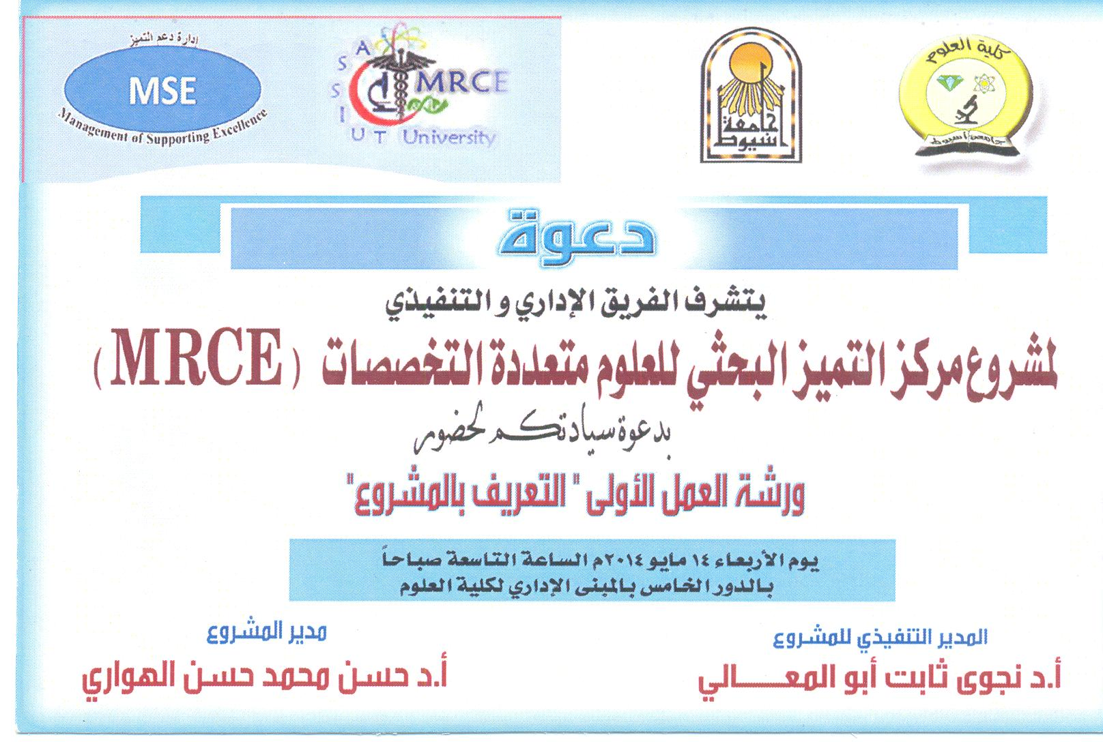

Slide 6

Multidisciplinary Research Centre of Excellence
(CEP1-043-ASSU)
By
Dr. Nagwa Abo El-Maali
Executive Project Manager

Slide 7
Definition
A multidisciplinary approach involves drawing appropriately from multiple disciplines to redefine problems outside of normal boundaries and reach solutions based on a new understanding of complex situations.

Slide 8
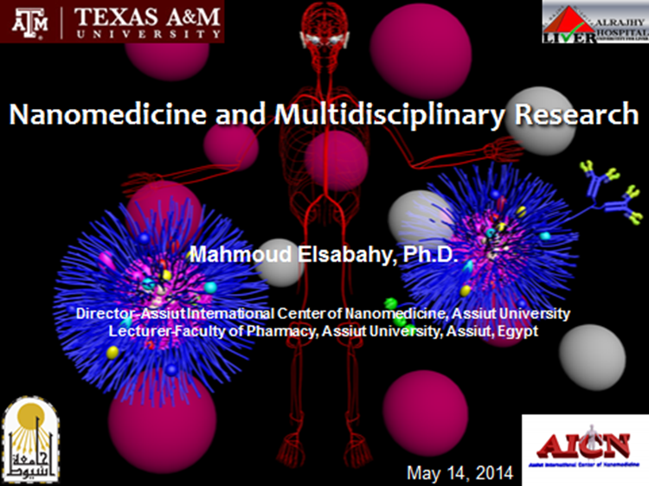

Slide 9
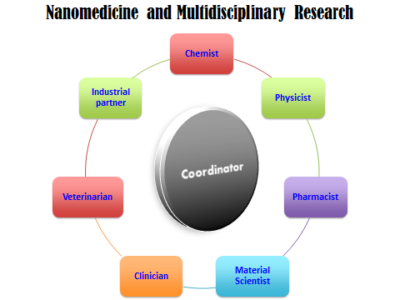

Slide 10

Neuro Psychiatric Disorders
of Genetic basis
By
Hamdy N.A. Eltallawy
Prof. of Neurology - faculty of
Medicine - Assuit University

Slide 11
I - Neurological Disorders:
- Alzheimer’s Disease
- Neuromuscular Disorders
- Epilepsy

Slide 12
FLOW CYTOMETRY:
PRINCIPLES AND APPLICATIONS
By:
Douaa Moh. Sayed

Slide 13
Definition
Flow cytometry is a technique for counting, examining, and sorting microscopic particles suspended in a stream of fluid.
It allows simultaneous multiparametric analysis of the physical and/or chemical characteristics of single cells flowing through an optical and/or electronic detection apparatus

Slide 14
Animal cell culture as an important tool for Biomedicine and Biotechnology
Gamal Badr
Associate Professor of Immunology

Slide 15



Multidisciplinary Reasearch Centre of Excellence (MRCE)
At
Assiut University

Slide 16
Strategic goal #1: Help guide Assiut University and the Community in educating the next generation of science and technology policy decision makers.
Objectives
Build a sustainable graduate science and technology policy education program at Assiut University.
Serve as a national role model in innovative biomedical (basic and applied) science and technology policy education.
Integrate faculty skills and expertise across disciplines and fields contributing to their professional development, research, and educational goals.
Enable Assiut University to serve as a leading voice in national and international biomedical (basic and applied) science and technology policy issues.

Slide 17
Strategic goal #2: Help make the nation’s science portfolios more responsive to societal needs. Example areas include health and disease, drug discovery, water purification, tissue culture, clinical chemistry, nanotechnology, biotechnology, and renewable/sustainable energy.
Objectives
Identify criteria for reconciling supply of and demand for scientific information in decision making.
Identify and present criteria for developing and evaluating broad portfolios of scientific and technological research.
Identify and develop relationships with our target audiences to learn about their information needs and how we can best assist them.
Develop an outreach strategy to disseminate the Center’s products to our target audience.

Slide 18
Strategic goal #3: Build a sustainable, diverse and productive institution at Assiut University.
Objectives
Achieve sufficient and stable funding to support the Center’s core activities.
Achieve a critical mass of personnel able to carry out the Center’s mission.
Coordinate a stable and productive research groups orchestrating in a multidisciplinary set-up.
Further improve and refine the Center’s governance structure to support growth and guide its future direction.
Develop the Center’s “brand.”

Slide 19
THE MRCE structure will have the following operation sections:
Administrative operation section Under the Centre Manager
Allied services operation section Under the Office Manager
Research Technical Support Units Under the Centre Manager
Education & Outreach Programs Under the Centre Manager
Advisory Committees
The MRCE will conduct research via:
Local collaboration
National Collaboration
International Collaboration

Slide 20
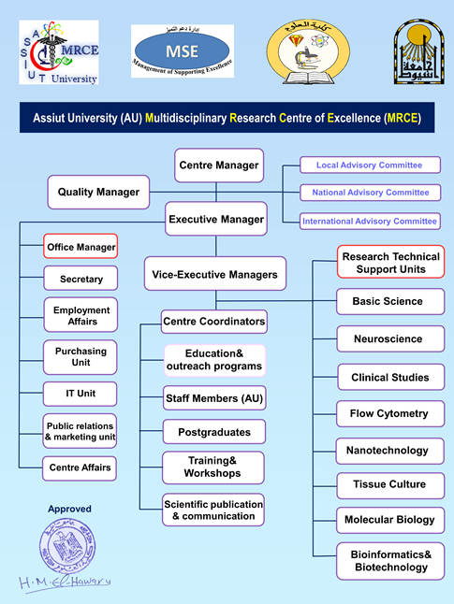

Slide 21





ممارسة
2 مناقصة
HR- TEM
أثاث
إحلال و تجديد

Slide 22
List of Suggested Staff Training and Development Programs
Non-technical Workshops
No. | Program Title | Date | Tutor(s)
1 | How to cope with the scientific literature | 27-28th September, 2014 | Dr. Refaat Hamed
2 | The team spirit | November 2014 | Dr. Ahmed Salem
3 | SPSS | January 2015 | Dr. Hassan ElHawary, Dr. Emad Hamdy
4 | Scientific writing skills and propoal handling | March 2015 | Dr. Heba Saad, and Dr. Doaa Mohammed
5 | Critical apprasal of clinical trials | May 2015 | Dr. Ahmed Salem
6 | Working with on-line databases and Bioinformatic analyses | July 2015 | Dr. Refaat Hamed

Slide 23
Technical workshops
No. | Program Title | Date | Tutor(s)
1 | DNA Apoptosis | October 2014 | Dr. Doaa Mohammed
3 | Interpretation of TEM data | December 2014 | Orbit Scientific representative
4 | Preparartion of Nanoparticles | February 2015 | Dr. Nagwa Abo Elmaali, Dr. Mahmoud El Sabahy
5 | HPLC and LC-MS | April 2015 | Dr. Refdaat Hamed
6 | Flowcytometry | June 2015 | Dr. Doaa Mohammed
7 | LAB Quality control/assurance | August 2015 | Dr. Nagwa Abo Elmaali
8 | GC-MS | September 2015 | Dr. Nagwa Abo Elmaali
10 | DNA and protein gel electrophoresis | October 2015 | Dr. Refaat Hamed
11 | Capillary electrophoresis | November 2015 | Dr. Nagwa Abo Elmaali

Slide 24
Workshop# 2
Non Technical

Slide 25
